Slide 1

Shop For Home
Pratik Gopal Jawale

Slide 2
Problem Statement
Shop For Home is a popular store in the market for shopping the home decor stuff. Due to Covid 19 all the offline shopping stopped. So, the store wants to move to the online platforms and wants their own web application.
To do the above web applications there are two users:-
1. User
2. Admin

Slide 3
SOLUTION
Hence E – commerce web application came into picture. Where the vendors can sell their products online so that customers don’t have to travel during these hard times and the business will be continued to run.

Slide 4
Objectives
Our existing system SHOP FOR HOME’s main objective is to allow people to buy and sell physical goods, services, and digital products over the internet. Through our SHOP FOR HOME website, a business can process orders, accept payments, manage shipping and logistics, and provide customer service.
The three main objectives are as follows :
Find the best solution for their needs
Make a purchase, and
Get information/answers to their questions

Slide 5
Abstract
E-Commerce is process of doing business through computers.
A user can easily access all the facilities of the Internet to buy or sell the products.
Unlike traditional commerce that is carried out physically with effort of a person to go & get products, ecommerce has made it easier for human to reduce physical work and to save time.
User can browse online shops, compare prices and order merchandise sitting at home on their PC.
To achieve this we used Java Full Stack to develop an ecommerce like our existing system SHOP FOR HOME.
We used angular for developing the frontend part and java spring boot for backend and to store the data we used H2 Database.

Slide 6
FUNCTIONAL REQUIREMENTS
User Stories –
1. As a user I should be able to login, Logout and Register into the application.
2. As a user I should be able to see the products in different categories.
3. As a user I should be able to sort the products.
4. As a user I should be able to add the products into the shopping cart.
5. As a user I should be able to increase or decrease the quantity added in the cart.
6. As a user I should be able to add “n” number of products in the cart.
7. As a user I should be able to get the Wish list option where I can add those products which I want but don’t want to order now.
8. As a user I should get different discount coupons.

Slide 7
FUNCTIONAL REQUIREMENTS
Admin Stories –
1. As an Admin I should be able to login, Logout and Register into the application.
2. As an Admin I should be able to perform CRUD on Users.
3. As an Admin I should be able to Perform CRUD on the products.
4. As an Admin I should be able to get bulk upload option to upload a csv for products details
5. As an Admin I should be able to get the stocks.
6. As an Admin I should be able to mail if any stock is less than10.
7. As an Admin I should be able to get the sales report of a specific duration.
8. As an Admin I should be able to set the discount coupons for the specific set of users

Slide 8
System Specifications SOFTWARE REQUIREMENTS
Technologies:
Angular
Java Spring Boot,
H2 Database
Languages:
Type Script
Java
IDE:
Eclipse
Vs code

Slide 9
System Specifications HARDWARE REQUIREMENTS
Operating System:
Windows 7/8/10/11
Linux distros
MacOS X or later.
Processor:
Intel or AMD dual core x86 processor.
Ram:
2 GB or above.
Hard disk:
500 MB of free disk space or more.

Slide 10
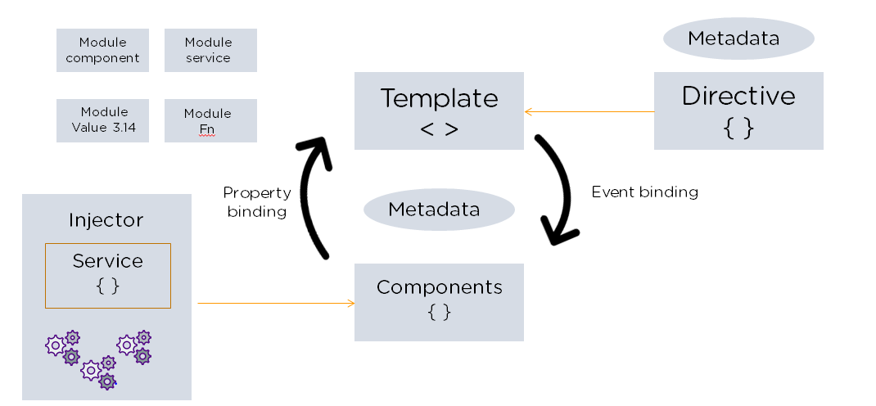
Angular Architecture

Slide 11
Angular Architecture
There are main eight blocks of Angular:
1. Module
2. Component
3. Metadata
4. Template
5. Data Binding
6. Service
7. Directive
8. Dependency Injection

Slide 12
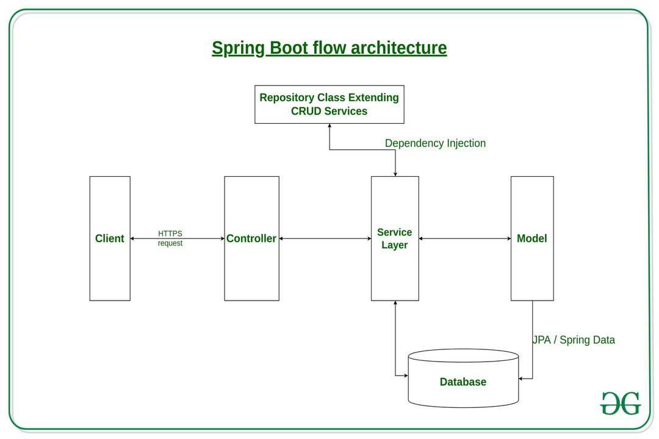

SpringBoot Architecture

Slide 13
SpringBoot Architecture
The spring boot consists of the following four layers:
1. Presentation Layer – Authentication & Json Translation
2. Business Layer – Business Logic, Validation & Authorization
3. Persistence Layer – Storage Logic
4. Database Layer – Actual Database

Slide 14
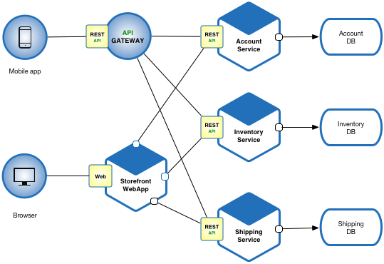
Micro service Architecture

Slide 15
Micro service Architecture
Typically, micro services are used to speed up application development.
Micro services architectures built using Java are common, especially Spring Boot ones.

Slide 16
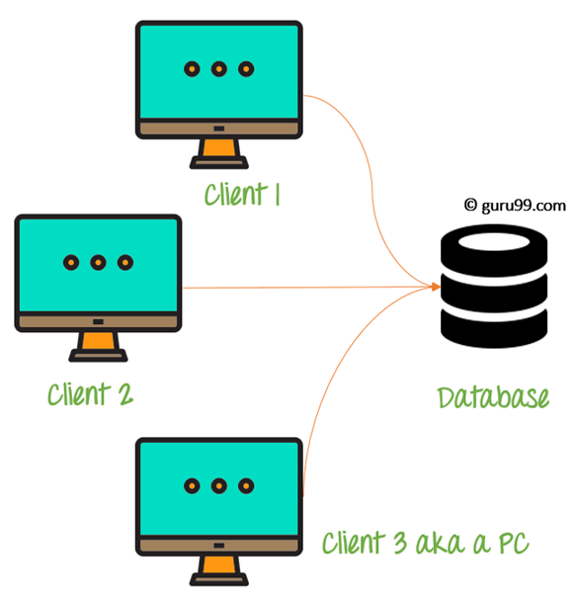
Data Base Architecture

Slide 17
Data Base Architecture
Entities in the Database include :
1. Product_Category
2. Product_info
3. Cart
4. Users
5. Wishlist

Slide 18
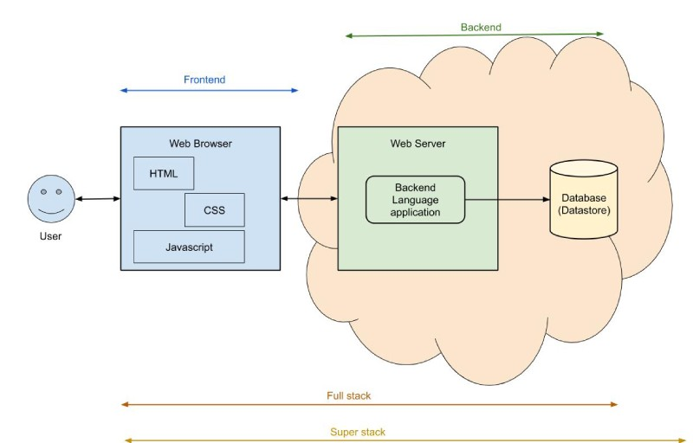
Total Project View

Slide 19
MODELING REQUIREMENTS

Slide 20
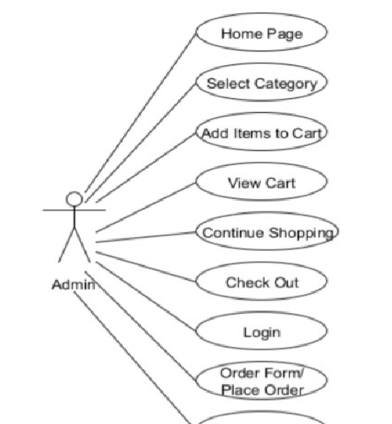





Functionality Of User:

Slide 21
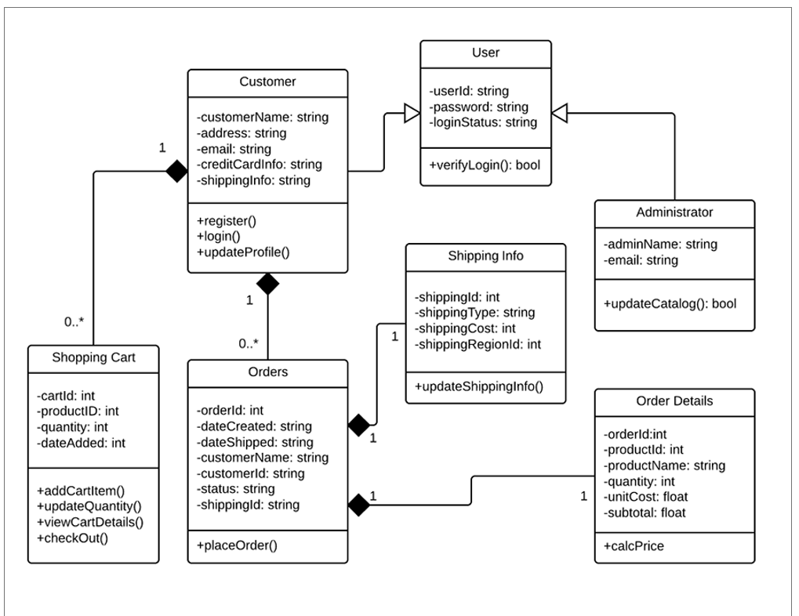
Class Diagram

Slide 22
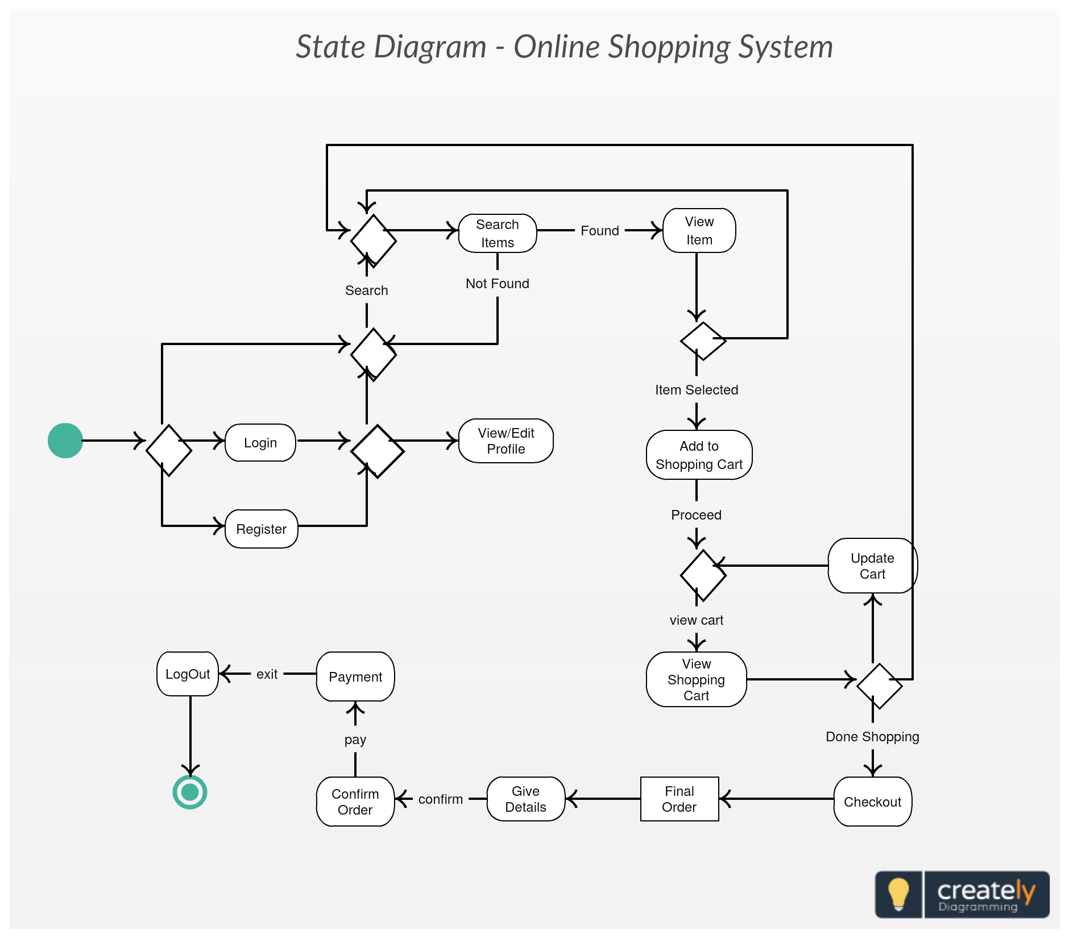

State Chart Diagram

Slide 23
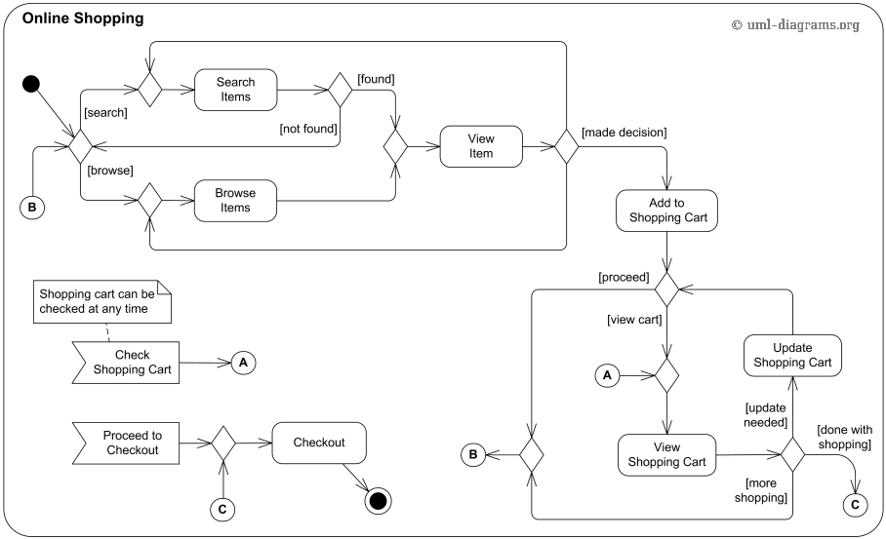
Activity Diagram

Slide 24
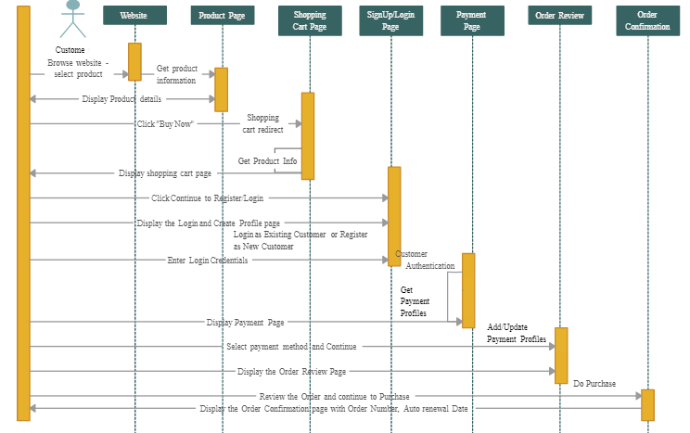




Sequence Diagram

Slide 25
Front end
Technologies Used:
1. Angular
2. Bootstrap

Slide 26
Backend
Technologies Used:
1. Java
2. Spring Boot
3. Maven

Slide 27
Data base
Technology Used:
1. H2 Database

Slide 28
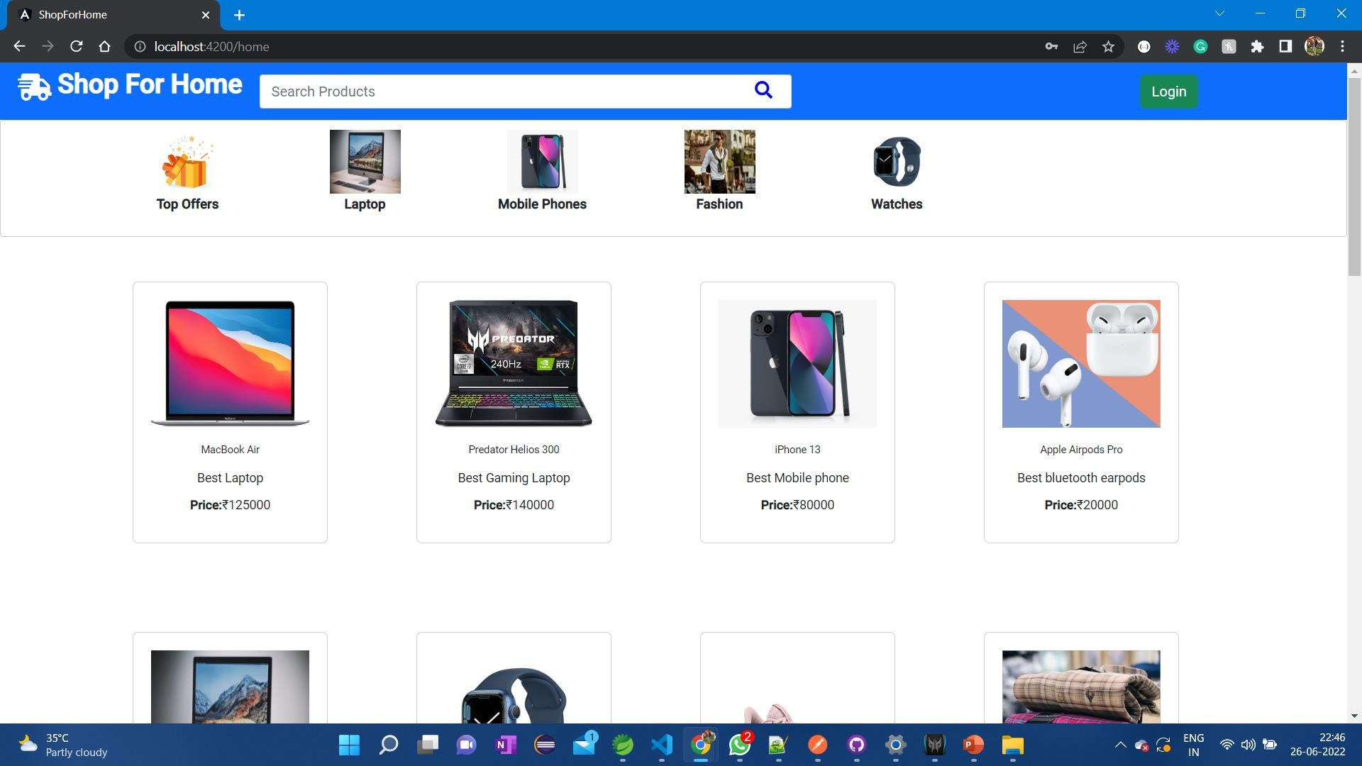

Slide 29
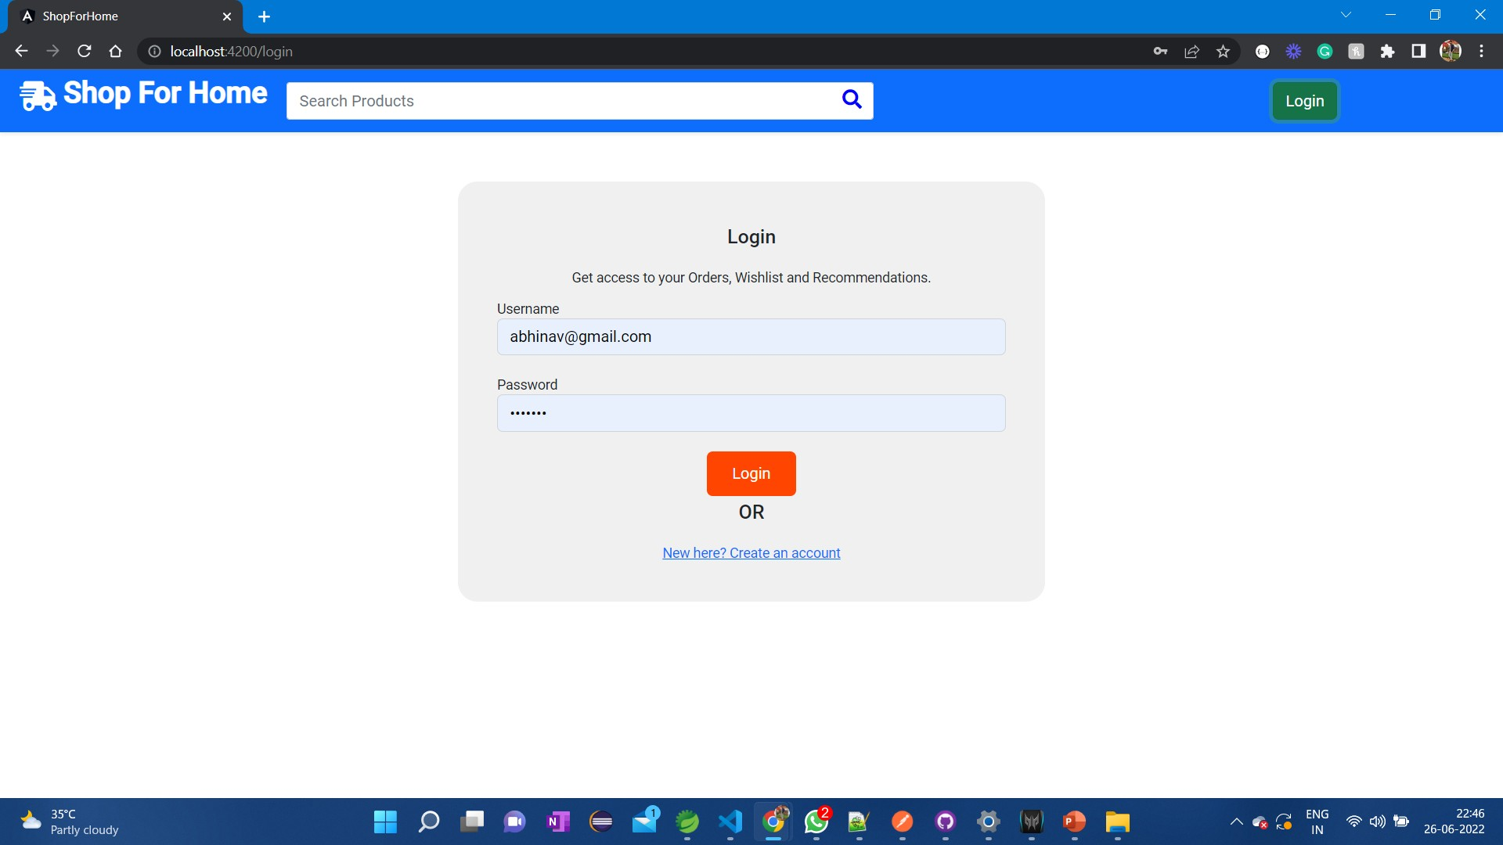

Slide 30
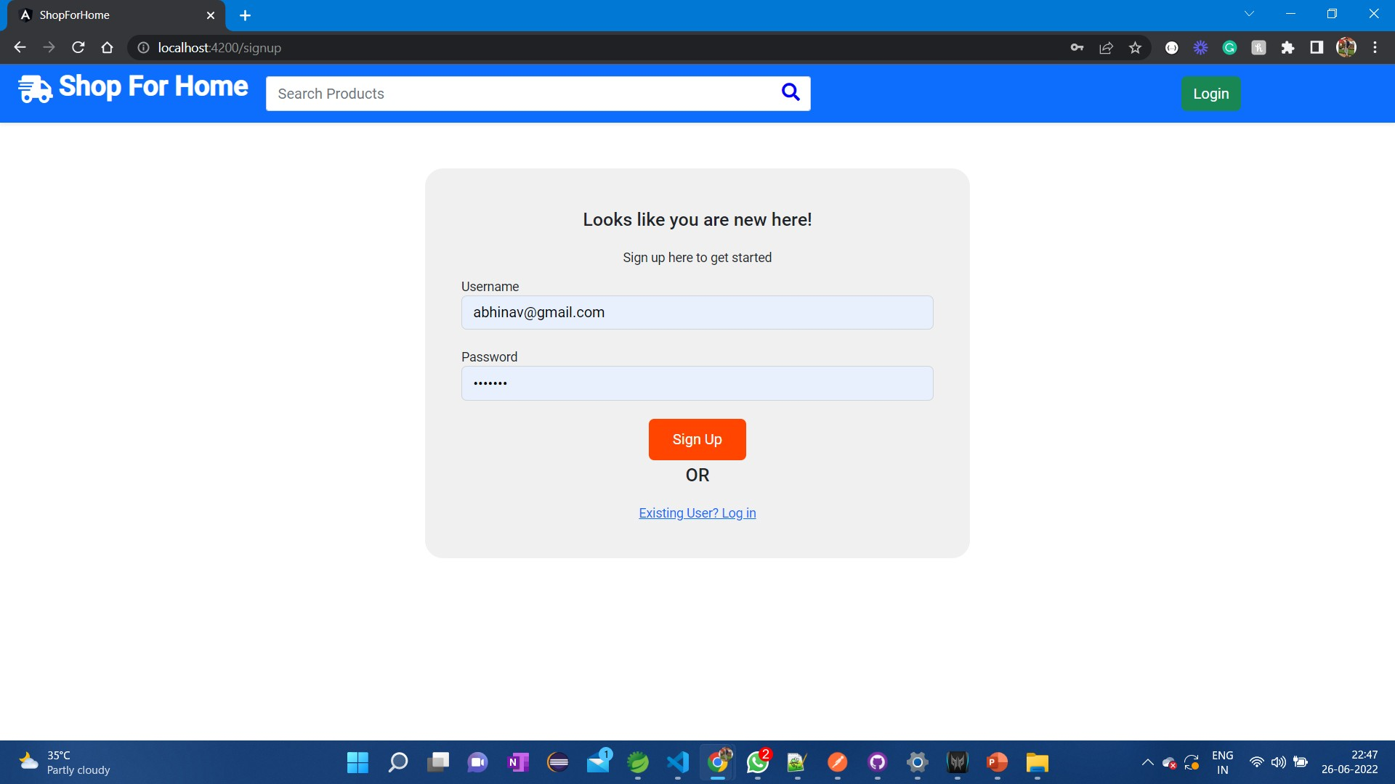

Slide 31
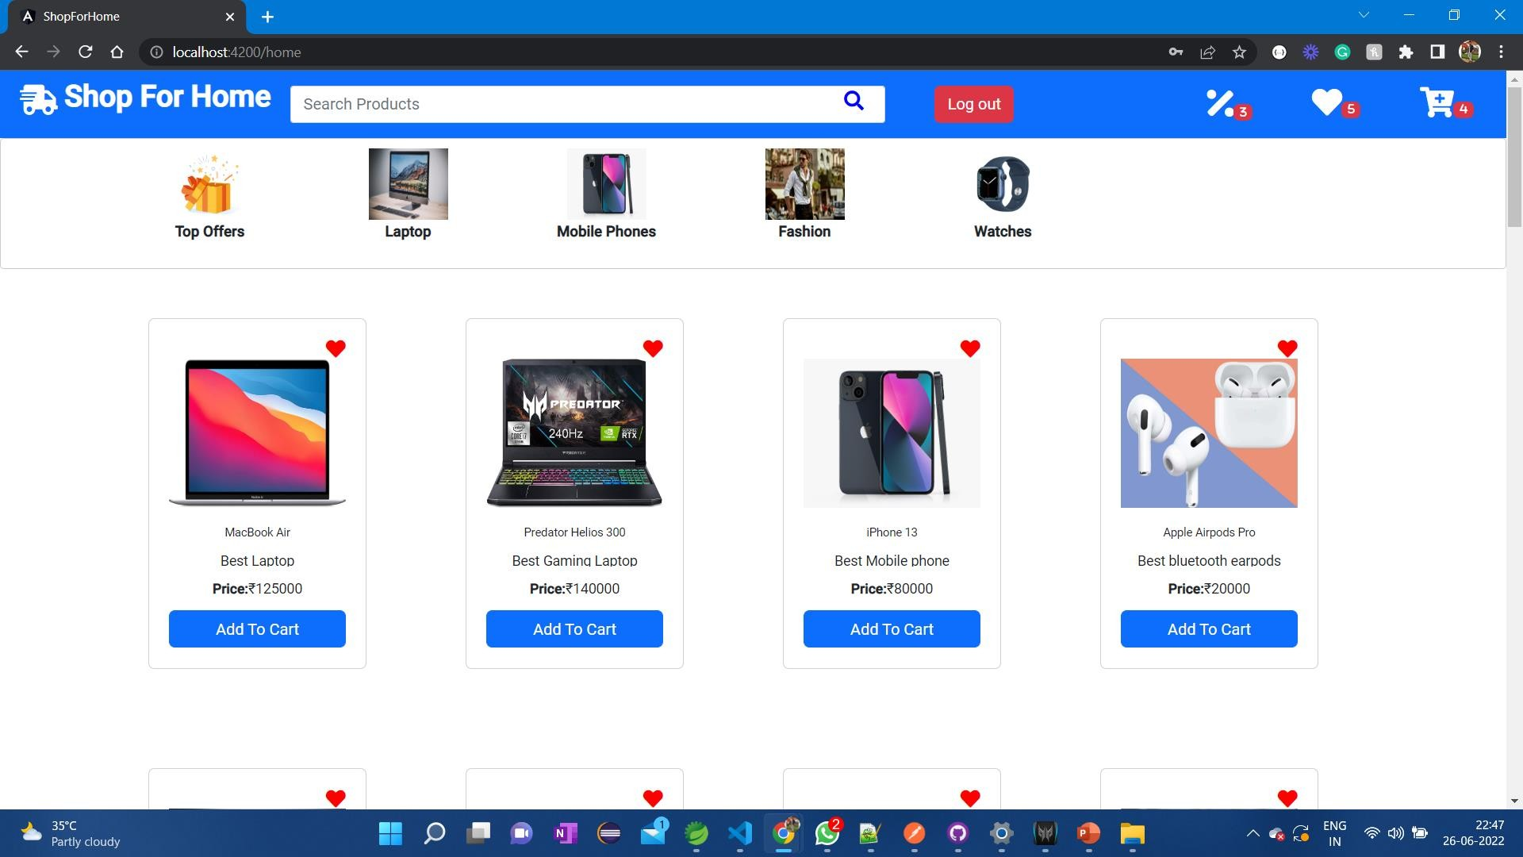

Slide 32
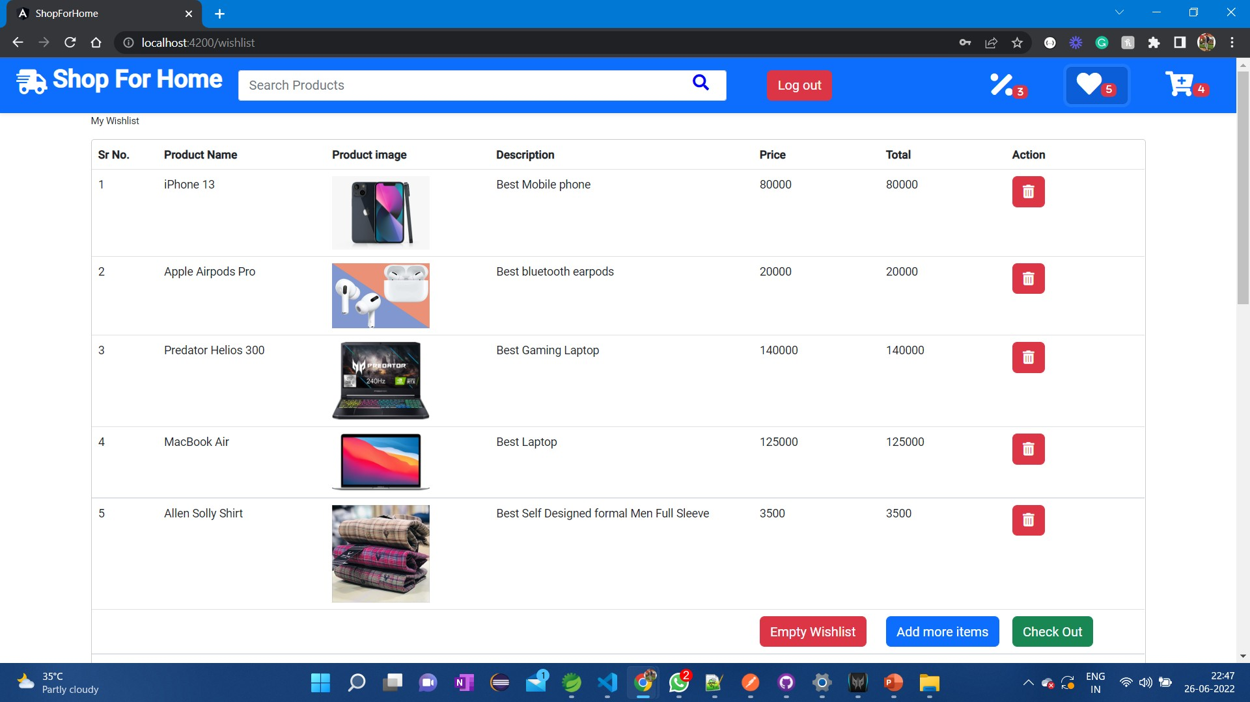

Slide 33
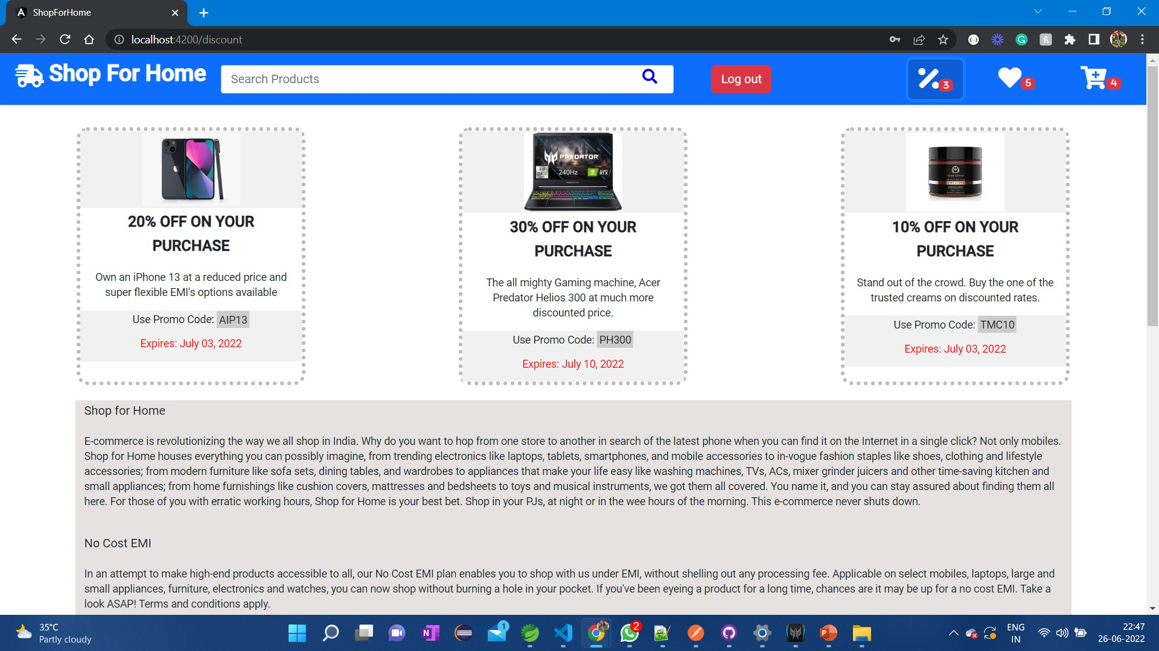

Slide 34
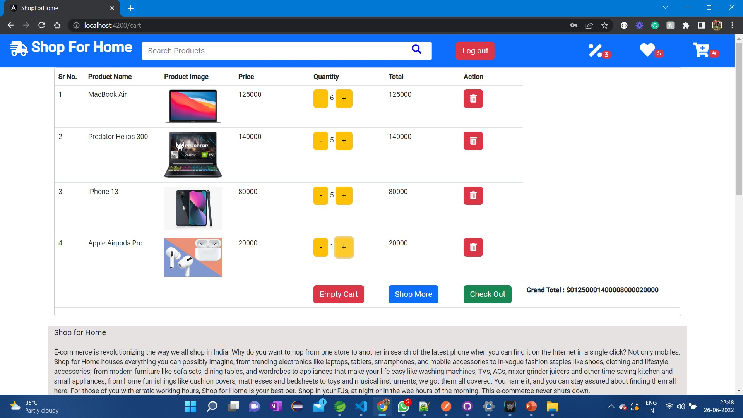

Slide 35
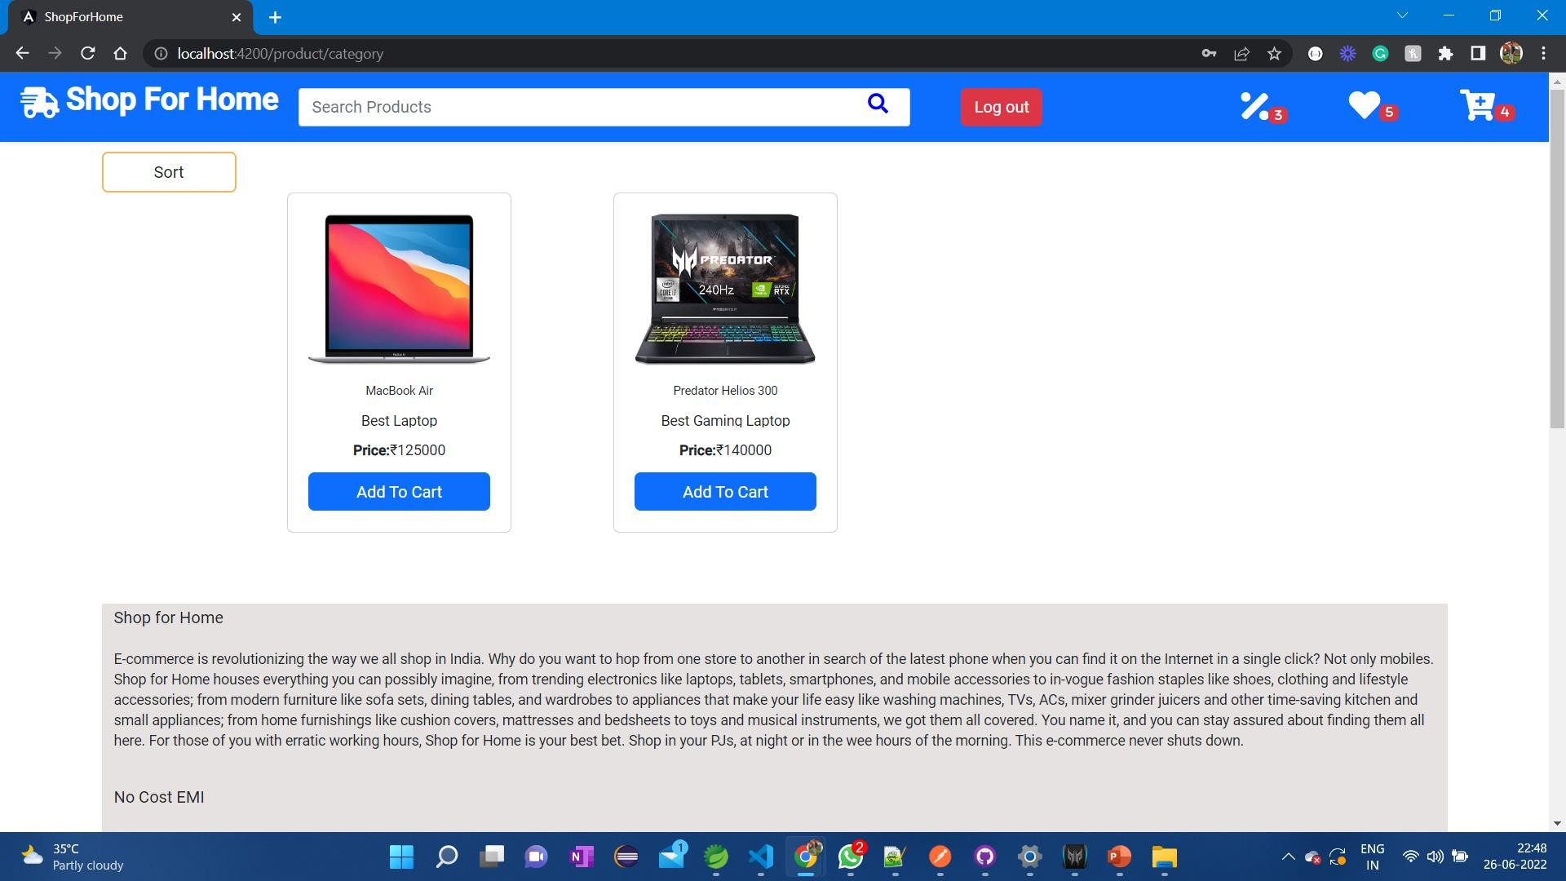

Slide 36
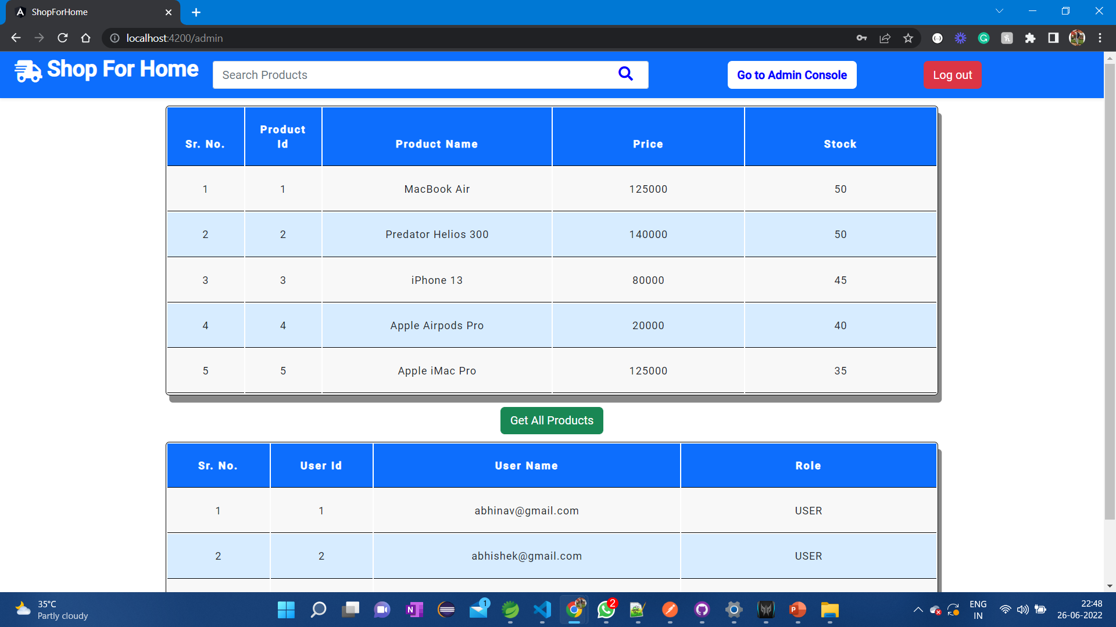

Slide 37
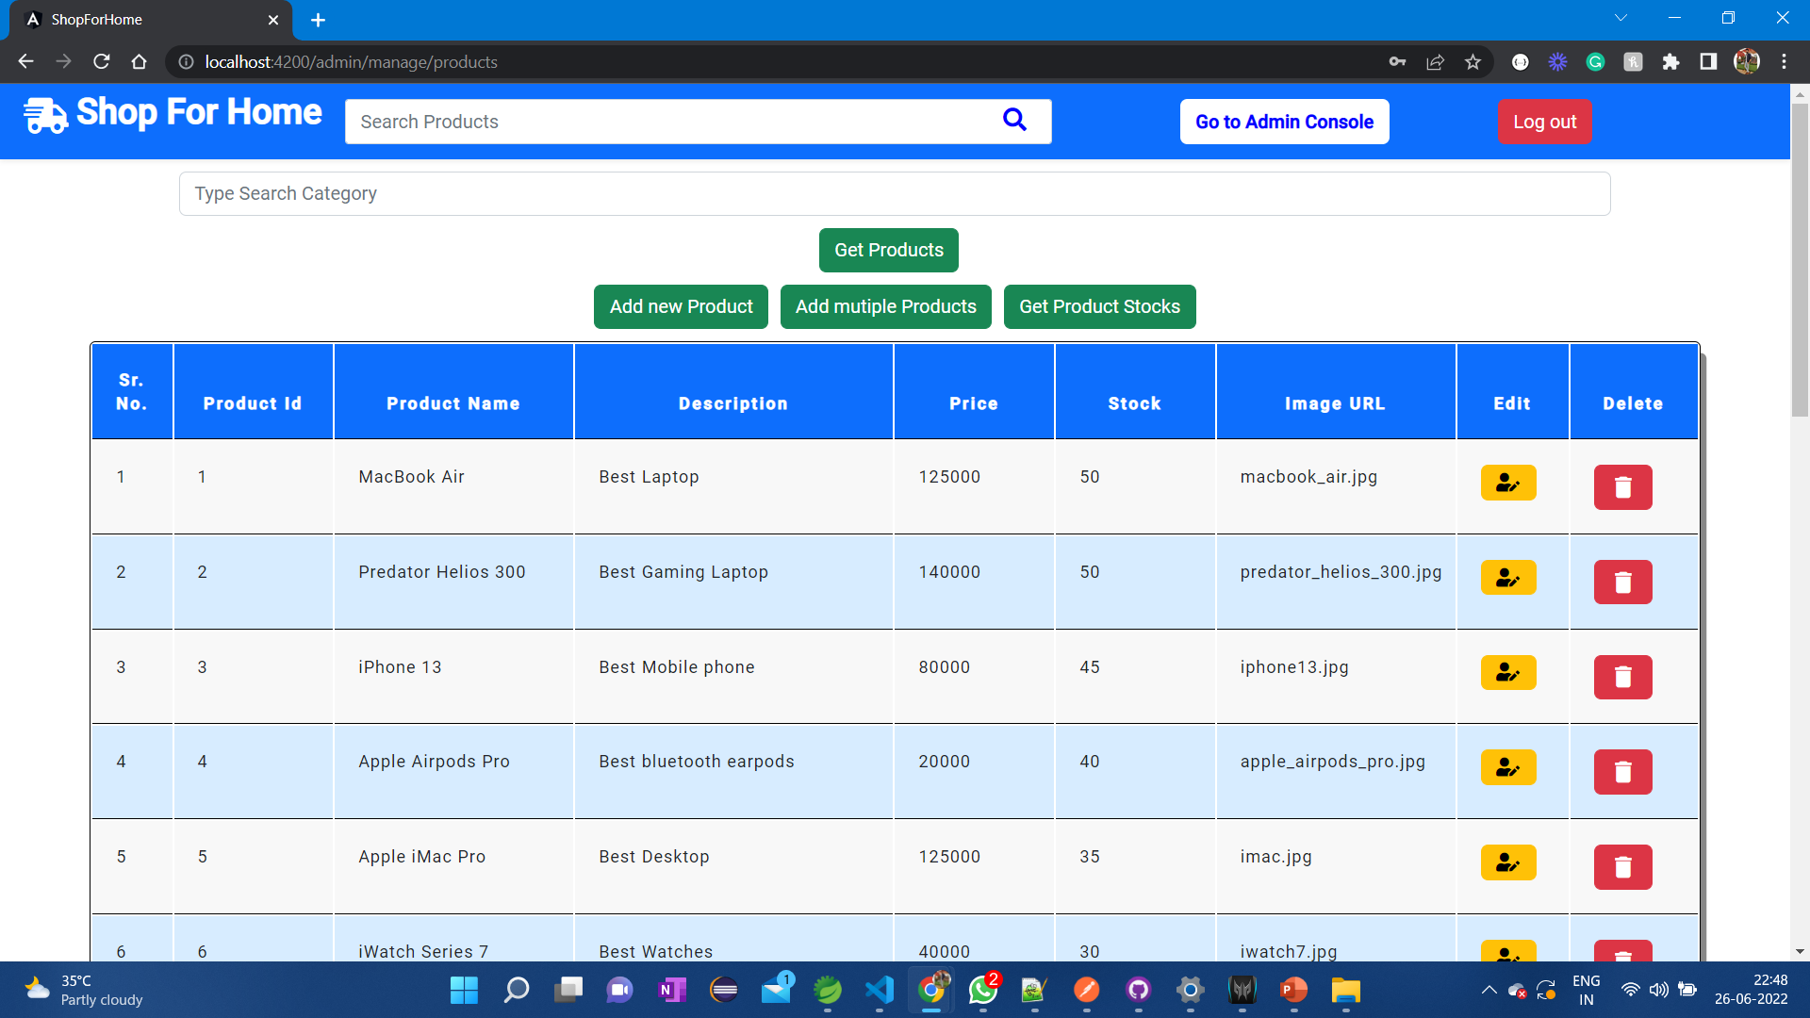

Slide 38
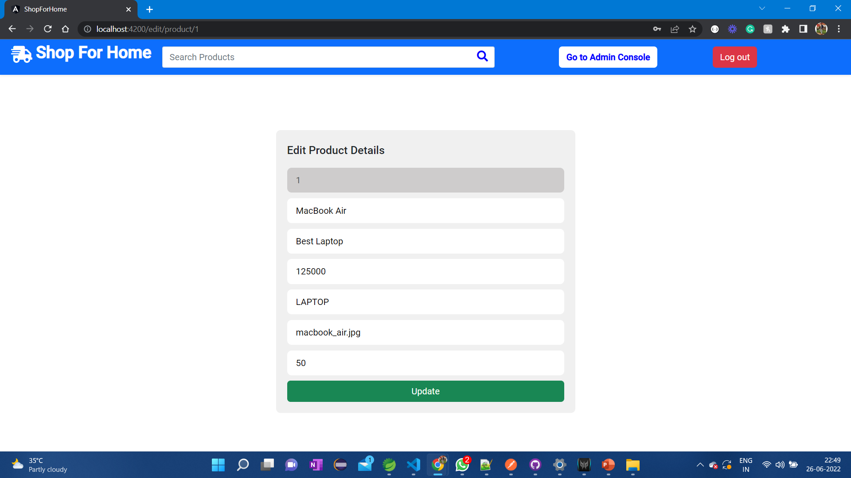

Slide 39
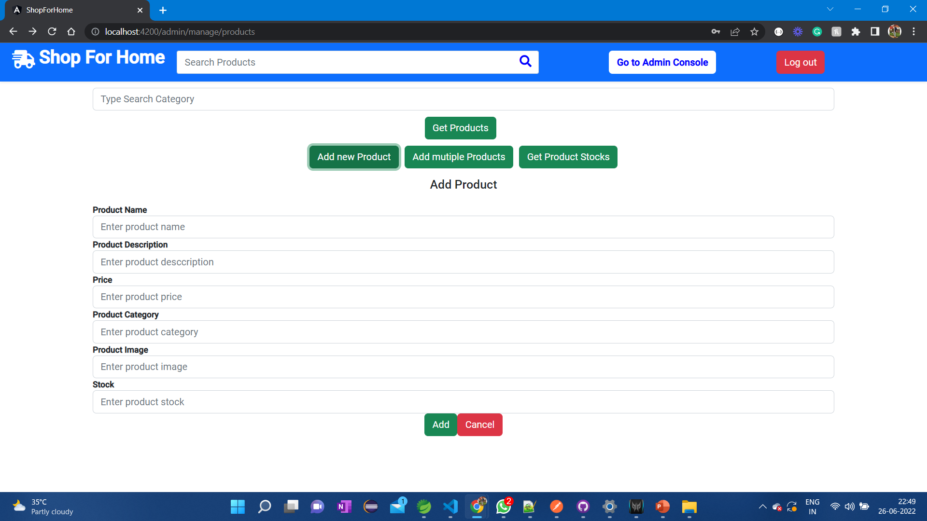

Slide 40
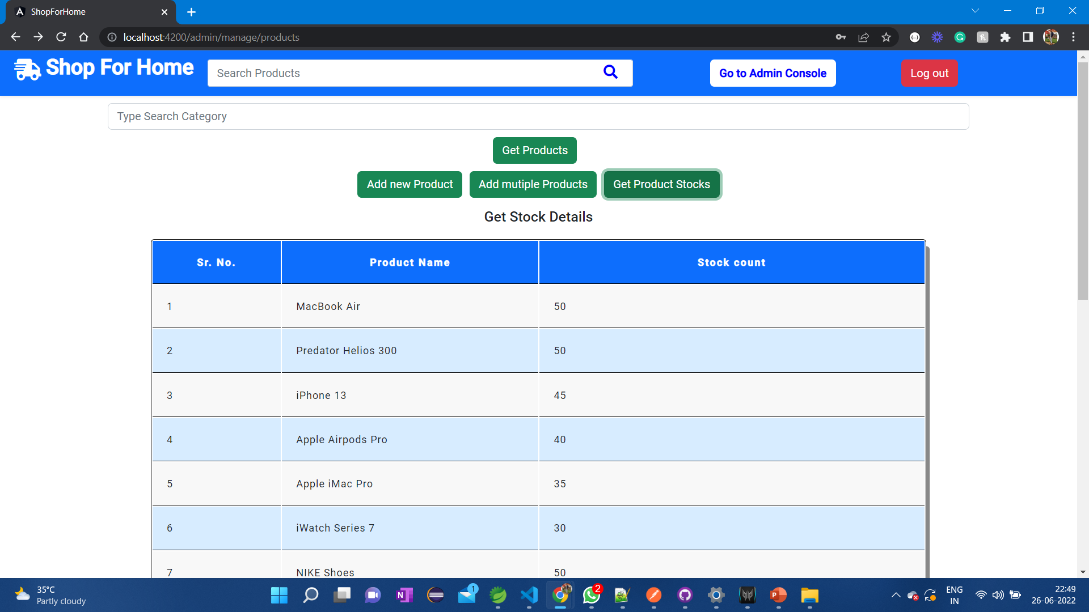

Slide 41
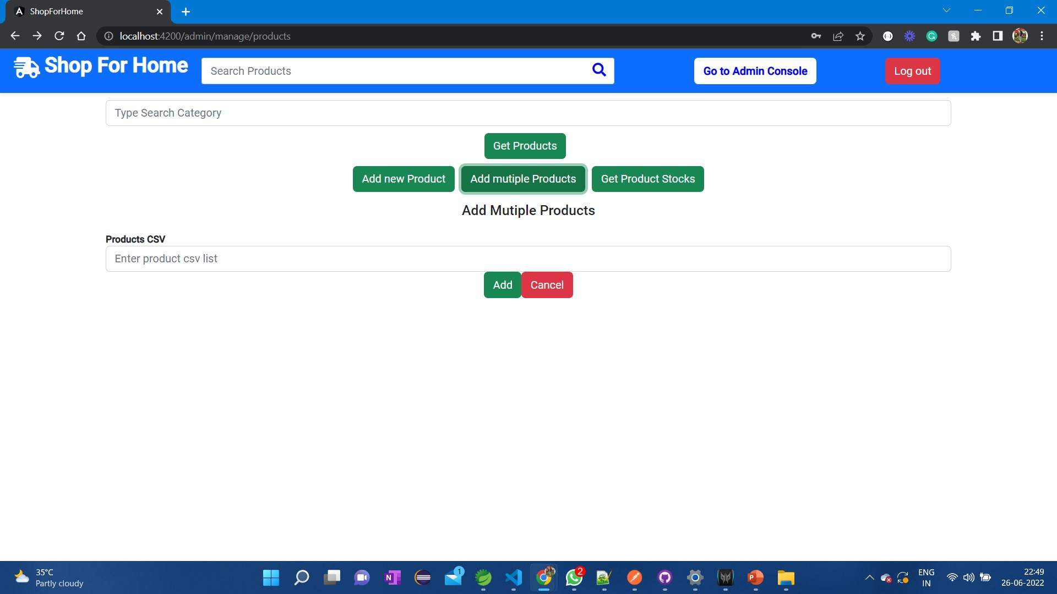

Slide 42
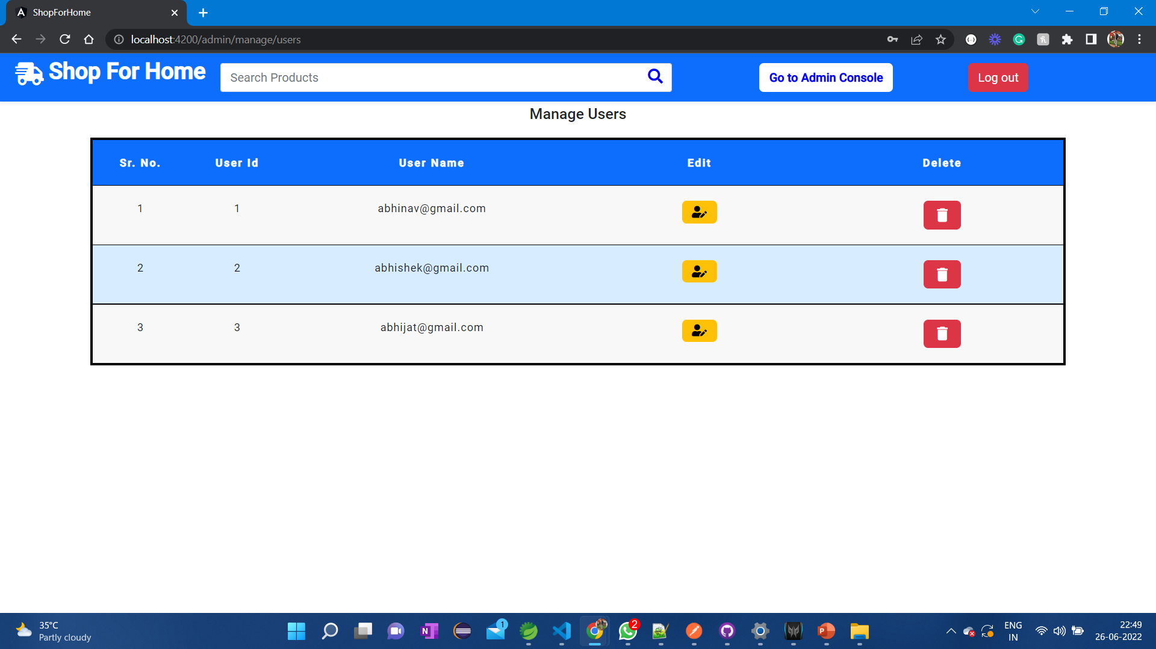

Slide 43
Thank You

